Slide 1

WP4
Creative use of AI
in Education
Centre for AI and Creativity
MishMash
Senter for KI og kreativitet
Notes:
Alexander

Slide 2
create
explore
reflect
for
through
in
MishMash will
on AI
creative practices.
Notes:
The for, through and in are important here!

Slide 3
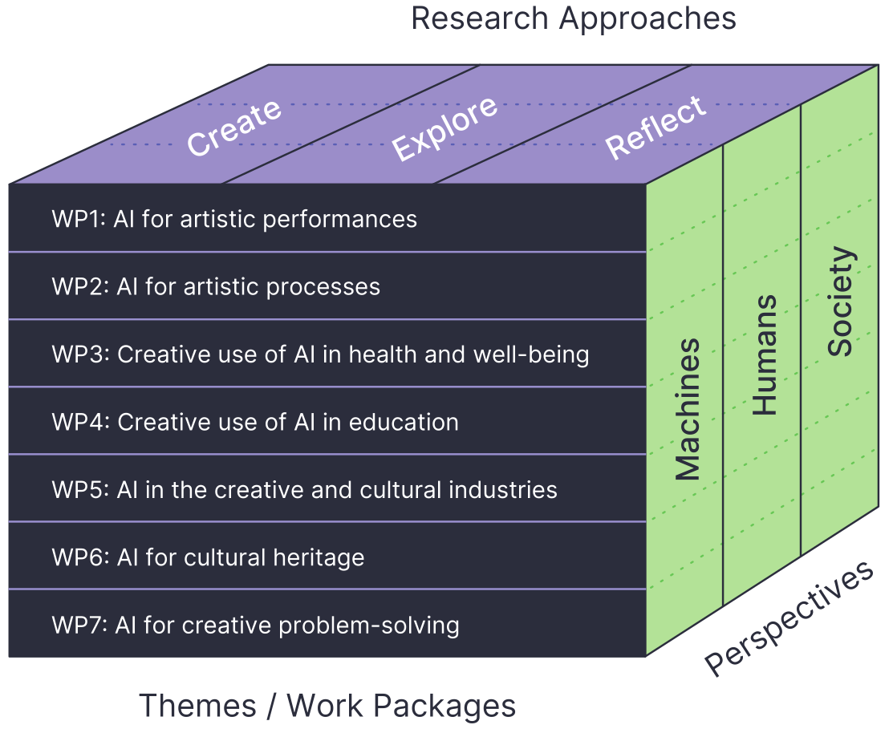
Notes:
Alexander

Slide 4

70 researchers
7 PhDs/Post-docs
Non-academic partners
+
Notes:
Alexander

Slide 5

Non-academic partners
Communication and working platform
Economic model and WP4 economic resources
Notes:
Alexander

Slide 6
?
How can Creative AI be integrated into education to enhance learning and foster AI literacy while considering diversity, justice, inclusion and well‐being?
Notes:
Alexander

Slide 7



Enhance learning opportunities
(in formal, informal and non-formal settings)
Foster creativity
Foster critical AI literacy
Notes:
Alexander

Slide 8
RQ4.1: How can Creative AI be effectively integrated to enhance teaching and learning and foster human creativity?
RQ4.2: How can the artistic use of AI within creative and fine arts education challenge and develop hierarchies of knowledge production in education and research?
RQ4.3: What measures can ensure that ethical considerations such as diversity, justice, fairness, inclusion, privacy, trust, and accessibility are central to implementing AI in creative education?
RQ4.4: How can the relationship between AI in formalised education and the application of AI in broader artistic practice be mapped and analysed to advance the use of Creative AI?
Notes:
Alexander

Slide 9
EXPLORE the artistic and pedagogical use of AI in formal, non‐formal and informal learning contexts, including developing a shared understanding of AI literacy for creative and fine arts education.
REFLECT on the implications of using AI in education to suggest frameworks and policy recommendations for using AI in education.
CREATE educational material, models and methods for broad applications through artistic and pedagogical practices with AI, emphasising ethical issues related to diversity, justice, fairness, inclusion, privacy, trust and accessibility.
Notes:
Alexander

Slide 10
Knowledge
Practices
Resources
Policy
Notes:
Alexander

Slide 11


Workshop December 4 in Oslo
Transfer RQs into projects and activities
Mapping networks and ongoing initiatives
Mapping state-of-the-art and connect internationally
Physical workshop
Notes:
Alexander

Slide 12


Physical Workshop March 10
2-3 WP-meetings/webinars
Defining and starting projects
Working with networks
PhD & Post-doc recruitments
Notes:
Alexander

Slide 13
How do we move forward with the Research Questions?
What are interesting directions for each RQ?
Anything currently going on/in planning that contributes to this understanding of the RQ, and if yes, what and how?
Can you think of any WP4-initiated projects that could/should be designed to (better) answer the RQs?
Notes:
Alexander

Slide 14
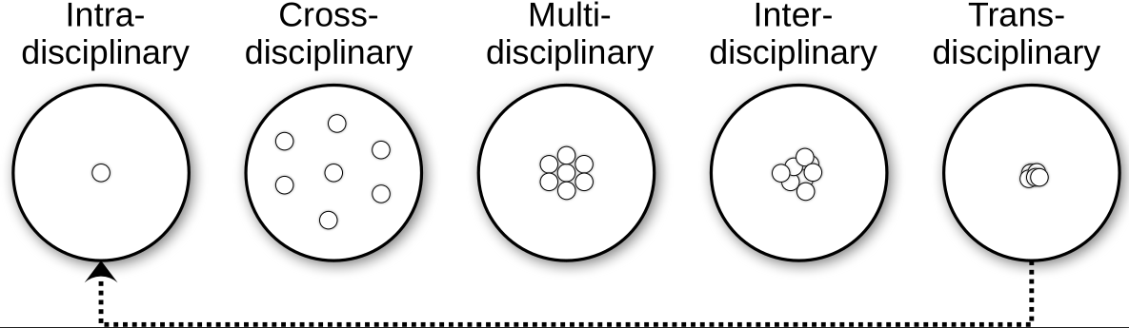
Notes:
Th

